Slide 1
PIP4004 - INTERNSHIP(Tech Mahindra) Review-4 Presentation
Group-16 RESEARCH PROJECT MANAGEMENT SYSTEM USING SPRINGBOOT
Student Details
NAME | ROLL NUMBER
Ayaluri Balaji Shiva | 20232MCA0037
Pasala Jaswanth | 20211CEI0121
Perisetty Uday Kiran | 20211CEI0153
Beduduri Sainath Reddy | 20211CEI0150
Under the Supervision of,
Dr. Jayanthi Kamalasekaran
Associate Professor
Presidency School of CSE(PSCS)
Presidency University
Name of the Program: B. Tech
Name of the HoD: Dr. Asif Mohamed H B
Name of the Program Internship Coordinator: Mr.Md Zia ur Rahman
Name of the School Project Coordinators: Dr. Sampath A K / Dr. Muthuraj/ Mr. Md Zia ur Rahman

Slide 2
Content
About Company Or Oganisation
Working domain or the technology
Challenges Faced in Internship
Objectives of the work
Literature Review
Proposed System
System Design And Implementation
Advantages of Proposed System/Work
Internship Roadmap
Screenshots
Github Link

Slide 3
About Company or Organization
Company Overview
Name: Tech Mahindra
Founded: 1986
Headquarters: Pune, Maharashtra, India
Global Presence: Global Presence in over 90 countries
Employees: Approximately 145,000
Industry: Information Technology (IT)Services and Consulting
Website: www.techmahindra.com

Slide 4
Working domain or the technology
Tech Mahindra Limited is a leading global provider of IT services and consulting, offering comprehensive solutions across a wide range of industries and advanced technology domains. The company serves key sectors such as telecommunications, banking and financial services (BFSI), manufacturing, healthcare and life sciences, retail, energy and utilities, automotive, media and entertainment, and the public sector. Renowned for its expertise in digital transformation, consulting, and business process reengineering, Tech Mahindra partners with clients worldwide to drive innovation and operational efficiency.
The company leverages cutting-edge technologies including artificial intelligence (AI), machine learning (ML), 5G network solutions, cloud computing (AWS, Azure, and Google Cloud), cybersecurity, the Internet of Things (IoT), blockchain, and robotic process automation (RPA). Additionally, Tech Mahindra provides services in application development and maintenance, enterprise resource planning (ERP) systems such as SAP and Oracle, DevOps, agile development practices, and emerging technologies like augmented reality (AR), virtual reality (VR), and the metaverse. The company also utilizes low-code and no-code development platforms to deliver scalable and efficient business solutions, helping organizations achieve sustainable growth and digital excellence.

Slide 5
Key Challenges & Issues Limited Interactivity: Without dynamic scripting, user interactions are restricted, reducing the ability to create a fully interactive user experience. Performance Optimization: Current static implementation may lead to longer load times for large assets; optimization techniques like lazy loading will be incorporated in the full-stack version. Scalability Constraints: The static setup lacks the capability to handle growing data volumes and user concurrency, which will be addressed with a scalable back-end architecture. Real-time Features: Features such as live updates, notifications, or real-time validations are not feasible without a full-stack implementation

Slide 6
Objectives of the Work
Simplify Project Submission: Allows faculty and researchers to submit new project proposals online, reducing paperwork and administrative delays.
Centralize Project Data: Consolidates all project information, including timelines, funding, team members, and progress reports into one centralized system for easy access and management.
Automate Approval Workflow: Streamlines the review and approval process with automated routing and notifications, ensuring faster decision-making and reduced bottlenecks.
Enhance Funding Management: Tracks funding sources, allocations, and expenditures, providing real-time financial overviews and minimizing budget overruns.
Improve Compliance Monitoring: Ensures adherence to institutional and regulatory guidelines through automated compliance checks and periodic reporting.
Real-Time Progress Tracking: Provides dashboards and real-time updates on project status, milestones, and deadlines, enabling proactive management.

Slide 7
Enable Collaboration: Facilitates seamless collaboration between departments, researchers, and external partners through shared access and communication tools.
Streamline Document Management: Digitally stores and organizes all project-related documents, proposals, reports, and approvals for quick retrieval and version control.
Generate Analytical Reports: Automatically creates statistical summaries, department-wise project distribution, funding utilization reports, and other key analytics for strategic decision-making.
Ensure Audit Readiness: Maintains comprehensive audit trails of project activities, modifications, and approvals, enhancing transparency and accountability.

Slide 8
Literature Review
[1] Project Management Institute, A Guide to the Project Management Body of Knowledge
(PMBOK® Guide), 6th ed. Newtown Square, PA: Project Management Institute, 2017.
[2] H. Kerzner, Project Management: A Systems Approach to Planning, Scheduling, and
Controlling, 12th ed. Hoboken, NJ: Wiley, 2017.
[3] J. R. Turner, Gower Handbook of Project Management, 5th ed. Abingdon, UK:
Routledge, 2016.
[4] R. K. Wysocki, Effective Project Management: Traditional, Agile, Extreme, 8th ed.
Hoboken, NJ: Wiley, 2019.
[5] A. Bryman, Social Research Methods, 5th ed. Oxford, UK: Oxford University Press,
2016.

Slide 9
[6] M. Saunders, P. Lewis, and A. Thornhill, Research Methods for Business Students, 8th
ed. Harlow, UK: Pearson Education, 2019.
[7] R. Burke, Project Management: Planning and Control Techniques, 5th ed. Hoboken,
NJ: Wiley, 2013.
[8] P. C. Dinsmore and J. Cabanis-Brewin, The AMA Handbook of Project Management, 4th
ed. New York, NY: AMACOM, 2014.
[9] J. W. Creswell and J. D. Creswell, Research Design: Qualitative, Quantitative, and
Mixed Methods Approaches, 5th ed. Thousand Oaks, CA: Sage Publications, 2017.
[10] J. Highsmith, Agile Project Management: Creating Innovative Products, 2nd ed.
Boston, MA: Addison-Wesley, 2010

Slide 10
Proposed System
1️⃣ Admin Access Module
The Admin can:
Add new research projects.
Edit existing project details.
Delete projects.
View statistical summaries and graphical analytics.
2️⃣ Faculty Access Module
The Faculty can:
Add new Research Projects corresponding to that Faculty.
Edit existing Faculty Projects details.
Delete Respective Faculty Projects.
View statistical summaries and graphical analytics of the Respective Faculty Projects.

Slide 11
3️⃣ Real-Time Dashboard and Reporting
The Admin dashboard displays:
Total Projects (e.g., 123 projects)
Completed Projects (e.g., 20 projects)
Funded Projects (e.g., 54 projects)
Total Funding Amount (e.g., ₹1,37,65,225.65)
The Facutly Dashboard displays:
Total Faculty Projects
Completed Faculty Projects
Funded Projects
Total Funding Amount for Respective Faculty Projects

Slide 12
Methodology Workflow
1. Login
The initial step is to log in to the Presidency University system. This involves providing an email and password on the login page.
2. Admin Dashboard Overview
After successful login, the user is directed to the Admin - Project Dashboard. This dashboard provides a high-level overview of the research projects. Key metrics displayed include:
Total Projects: 123
Completed Projects: 20
Funded Projects: 64
Total Funding Amount: ₹1,37,65,225.65
The dashboard also presents visual distributions:

Slide 13
Department-wise Project Distribution: A bar chart showing the number of projects per department (CSE, ME, CE, EE, ECE).
Distribution of In-House vs. Funded Projects: A pie chart indicating the percentage of in-house (44%) versus funded (56%) projects.
3. Project Management - View & Search Projects
From the dashboard, the user can navigate to the Project Management section, which allows for viewing, adding, updating, or deleting projects. This section displays a table of "Research Projects" with columns such as:
Project ID
Title
Description
Status (e.g., Paused, Ongoing, Proposed)

Slide 14
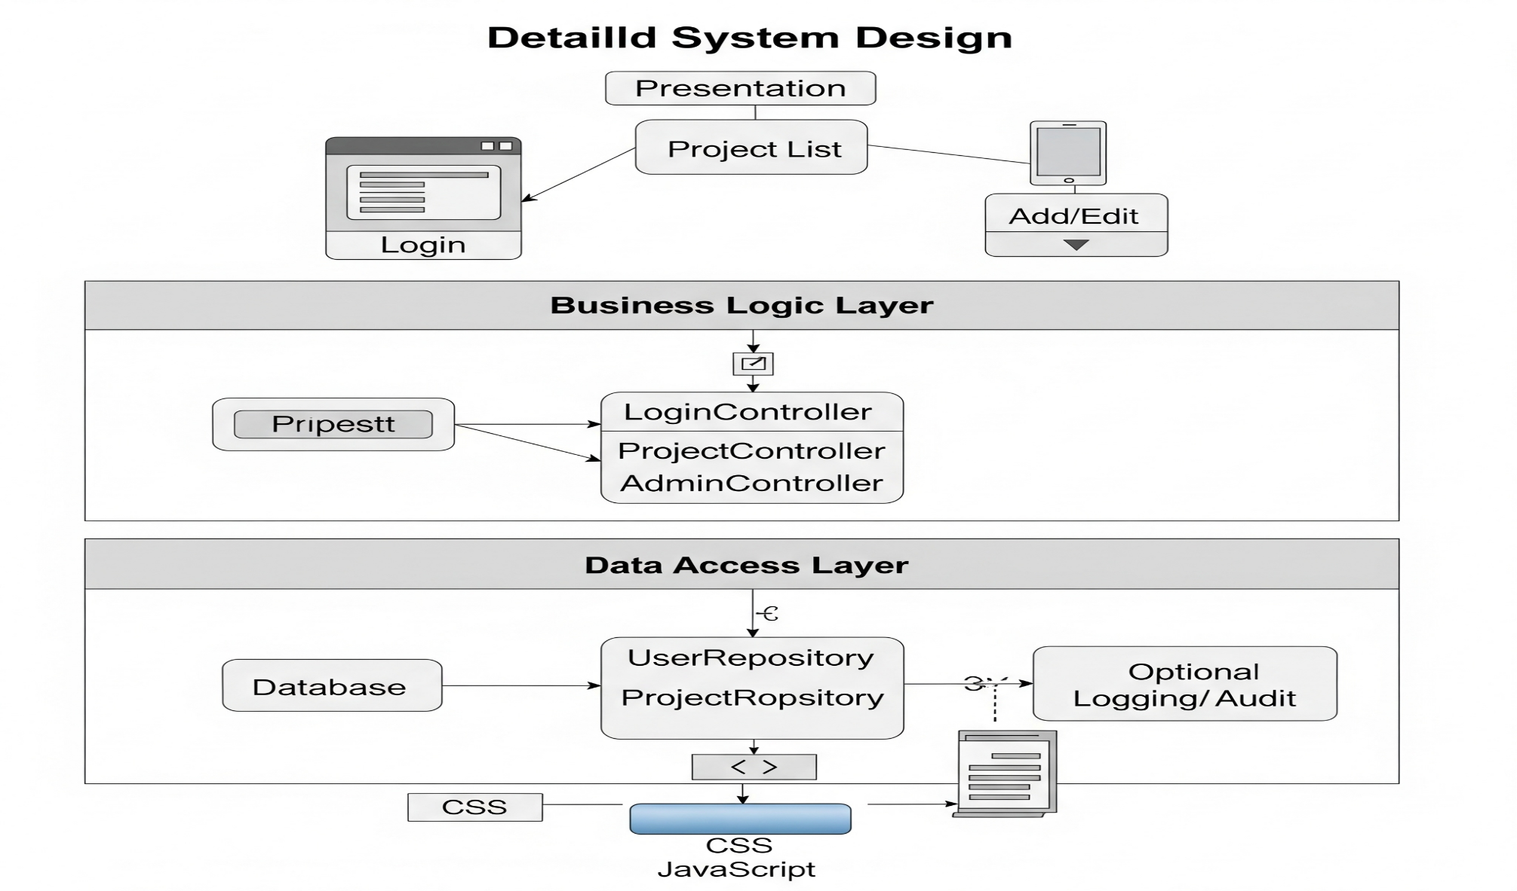
System Design And Implementation

Slide 15
Workflow Description
User Login: The workflow begins with a user accessing the Presidency University Home page, where they are presented with a login interface. The user must provide their email and password to proceed. Successful authentication grants access to the system.
Access Admin Dashboard: After logging in, an administrator is directed to the "admin - Project Dashboard." This dashboard provides a high-level overview of all research projects, including:
Total Projects
Completed Projects
Funded Projects
Total Funding Amount
Visual distribution of projects by department
Distribution of in-house vs. funded projects
Navigate to Project Management: From the dashboard, the user can navigate to the "Project Management" section, which is dedicated to managing "Research Projects." This section allows administrators to add, update, or delete projects.

Slide 16
View and Search Projects: Within the Project Management section, a table lists all research projects,
displaying details such as Project ID, Title, Description, Status, Start Date, End Date, Faculty ID, Department,
Project Type, Funded Amount, and Funding Agency. A search bar is available to filter projects, and pagination
allows Browse through multiple entries.
Add a New Project: To add a new project, the administrator clicks the "+ Add Project" button.
This action opens a "New Project Details" form where various fields like Project ID, Title, Description, Status
(e.g., Proposed), dates, Faculty ID, Department, Project Type (e.g., Inhouse), Funding Agency, and Funded
Amount can be entered. The user then clicks "Submit" to save the new project or "Cancel" to discard it.
Edit an Existing Project: To modify an existing project, the administrator clicks the "Edit" icon (pencil) in the
"Action" column for a specific project in the list. This opens an "Edit Project Details" form, pre-populated with
the current project's information, allowing for updates to any of the fields. Similar to adding a project, the user
clicks "Submit" to save changes or "Cancel".

Slide 17
Advantages of Proposed System/Work
Centralized Project Overview: The "Admin - Project Dashboard" provides a quick and comprehensive summary of all projects, including total projects, completed projects, funded projects, and total funding amount. This centralized view aids in high-level tracking and reporting.
Visual Data Representation: The dashboard includes graphical distributions of projects by department and funding type (in-house vs. funded). This visual approach helps in quickly understanding project demographics and funding trends.
Streamlined Project Management: The "Project Management" section allows for efficient "Add, Update or Delete Projects". This indicates a direct and intuitive way to maintain project records.

Slide 18
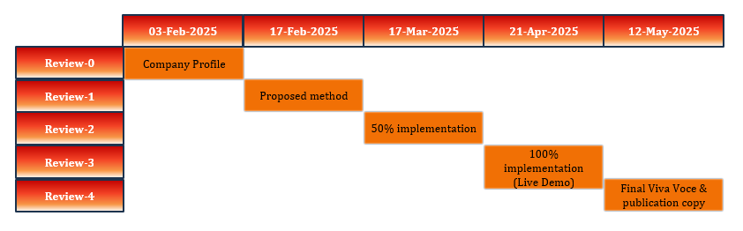
Internship Road Map

Slide 19
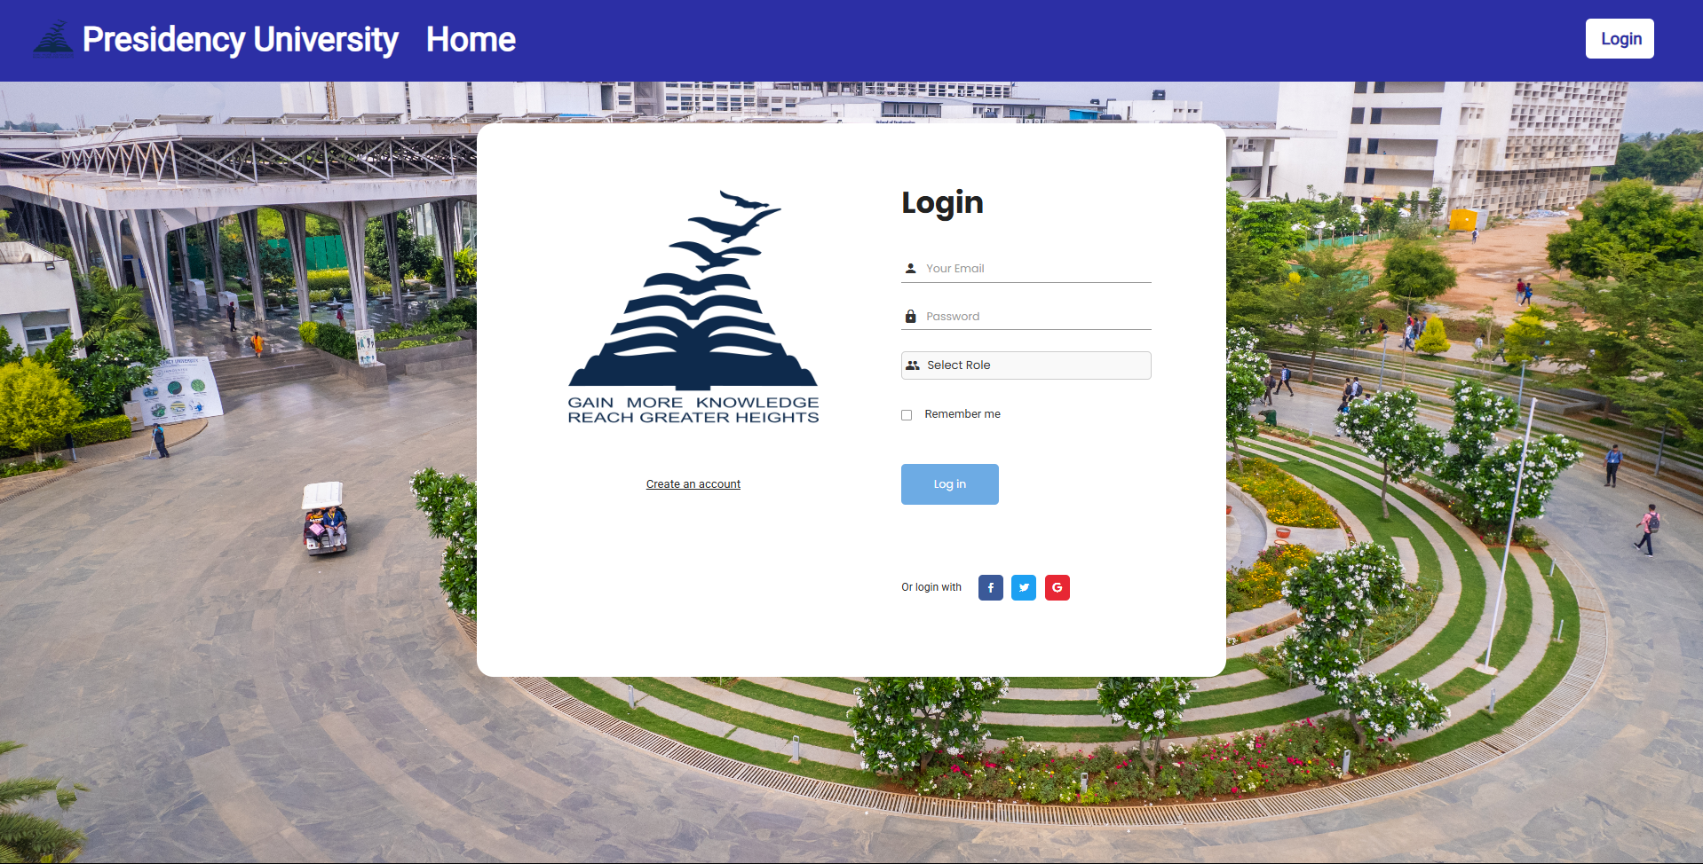
Screenshots

Slide 20
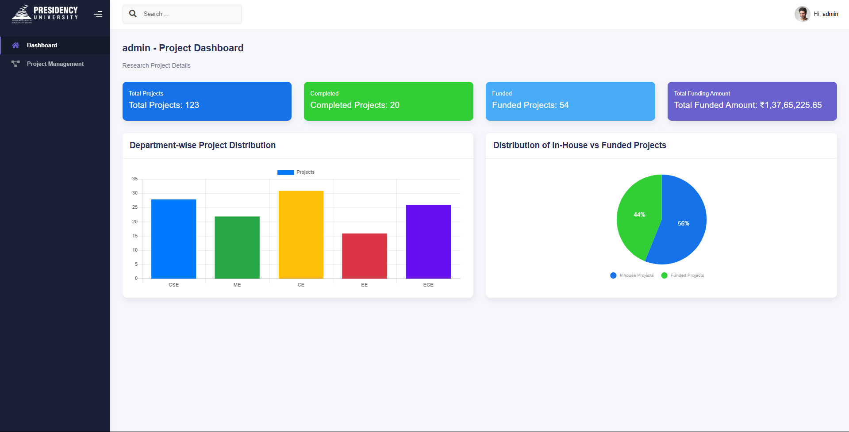
Screenshots

Slide 21
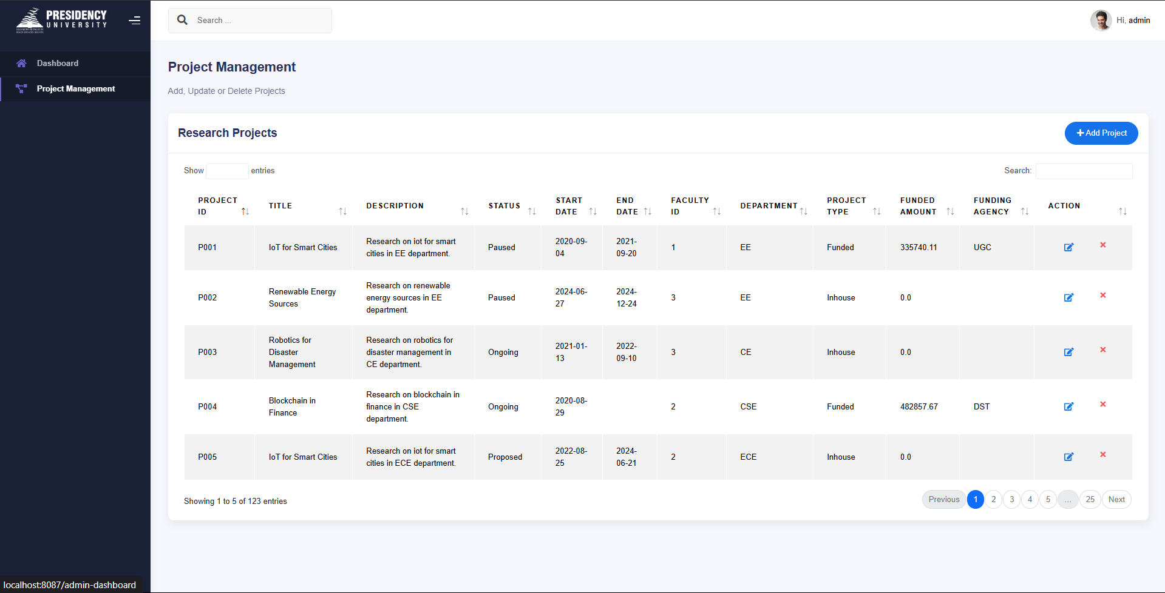
Screenshots

Slide 22
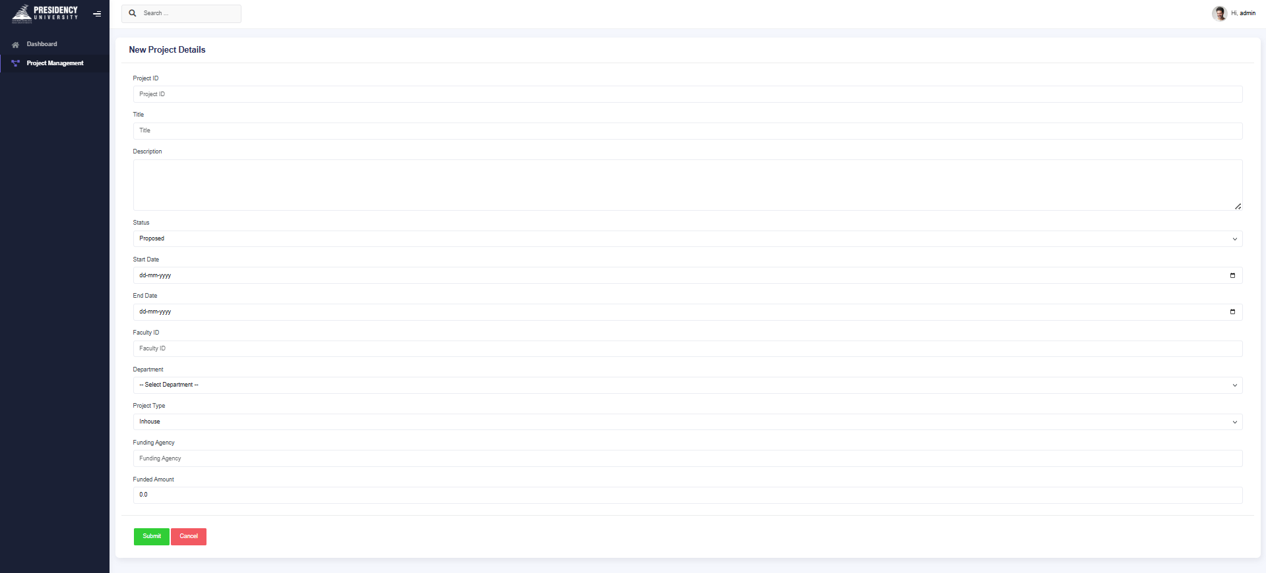
Screenshots

Slide 23
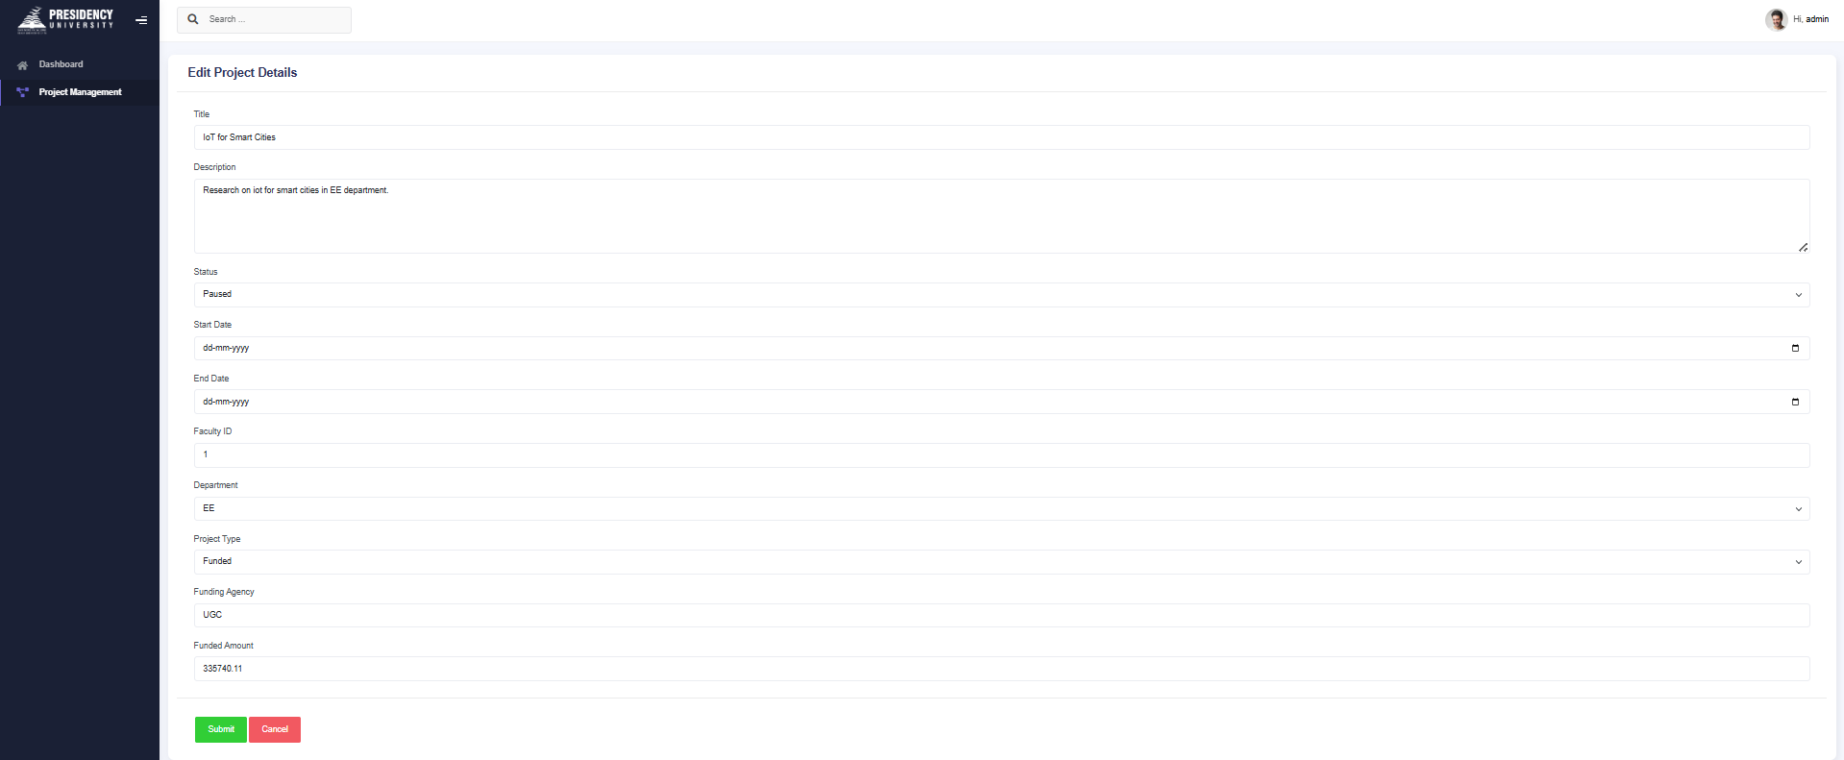
Screenshots

Slide 24
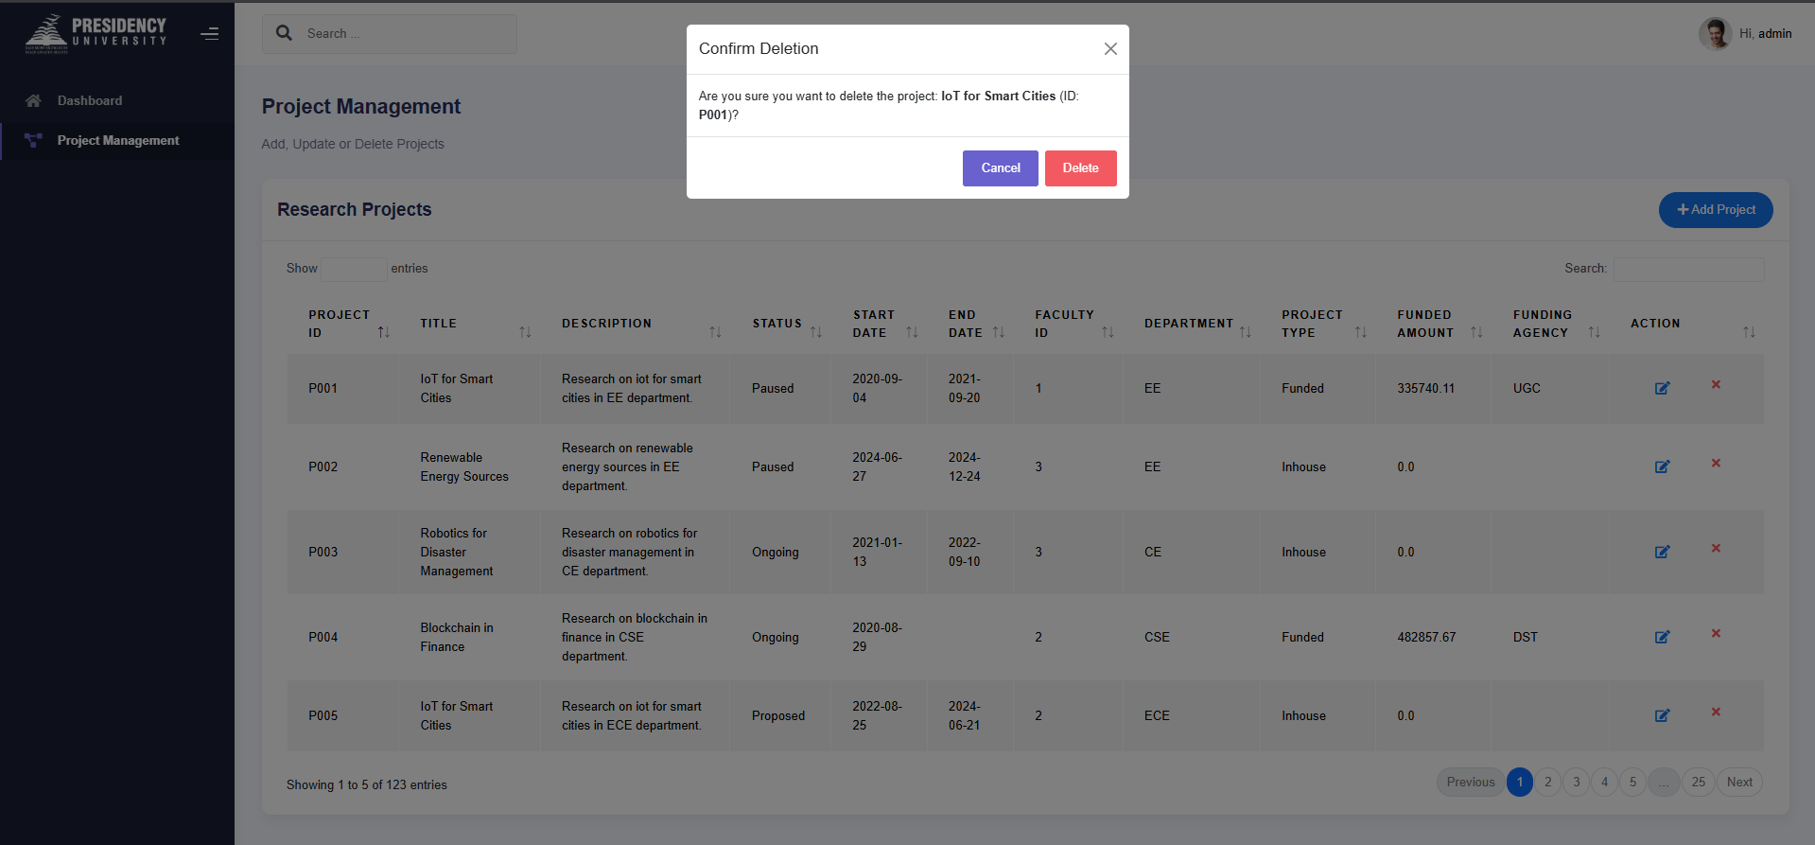
Screenshots

Slide 25
Github Link
Link: Sainath-Reddy/TechMProject

Slide 26
Thank you !!

